Slide 1
Syntax Analysis

Slide 2
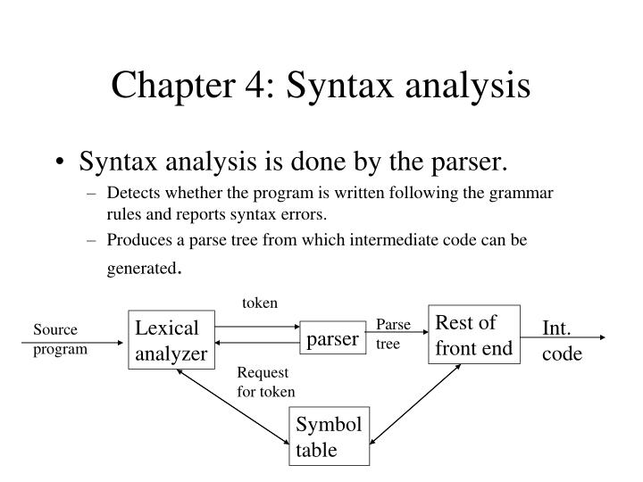
Role of a Parser

Slide 3
Context free grammars
Regular language does not support nested construction
A grammar G = (N, T, P, S) is context free grammar, if each production P is of the form
A → α,
where A є N and
α є (N U T)*
N is a finite set of Non-terminals
T is a finite set of Terminals
P is the set of Productions
S is the Start symbol
Example:
exp → exp op exp
exp → (exp)
exp → number
op → +
op → -
op → *

Slide 4
Context free grammars
Regular language does not support nested construction
A grammar G = (N, T, P, S) is context free grammar, if each production P is of the form
A → α,
where A є N and
α є (N U T)*
N is a finite set of Non-terminals
T is a finite set of Terminals
P is the set of Productions
S is the Start symbol
Example:
exp → exp op exp | (exp) | number
op → + | - | *

Slide 5
Derivation
Leftmost derivation
exp => exp op exp => exp op exp op exp => number op exp op exp
=> number – exp op exp => number – number op exp
=> number – number * exp => number – number * number
Rightmost derivation
exp => exp op exp => exp op exp op exp => exp op exp op number
=> exp op exp * number ……
Sentence: a string of terminal symbols that can be derived from S
Sentential form: a string of terminals and non-terminals that can be derived from S

Slide 6
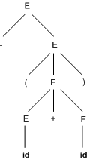
Parse Tree
Grammar :
E -> E + E | E * E | -E | (E) | id
Derivation for –(id+id)
E => -E => -(E) => -(E+E) => -(id+E)=>-(id+id)

Slide 7
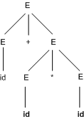
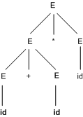
Ambiguity
More than one leftmost derivation or more than one rightmost derivation.
For example, for the sentence id + id * id

Slide 8
Elimination of ambiguity
exp → exp op exp | (exp) | number
op → + | - | *
Adding precedence
exp → exp addop exp | term
addop → + | -
term → term mulop term | factor
mulop → *
factor → (exp) | number
With left associativity
exp → exp addop term | term
addop → + | -
term → term mulop factor | factor
mulop → *
factor → (exp) | number

Slide 9

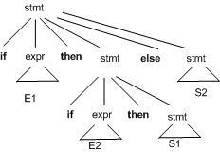
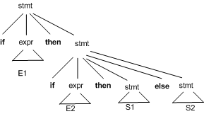
Dangling Else
If E1 then if E2 then S1 else S2

Slide 10
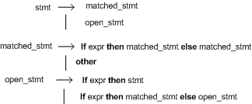
Elimination of ambiguity

Slide 11
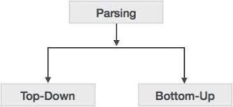
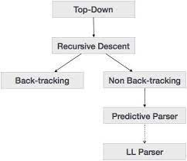
Parsing
Parsing is a process of determining if a string of tokes can be generated by a grammar
Top-down parsing constructs a parse tree for the input string, starting from the root and creating the nodes of the parse tree in preorder.

Slide 12
Top-down Parsing
Top-down parsing traces out the steps in a leftmost derivation.
At each step the key problems is
How to choose a production to be applied for a non-terminal A
Recursive-descent parsing is a general form of parsing that consists of a set of procedures, one for each non-terminal.
It starts with the start symbol S
Recursive-descent parsing may need backtracking

Slide 13
Example
E → E+T | T
T → T*F | F
F → (E) | id
Derive id + id * id
Start symbol is E
Which production to be applied first?

Slide 14
Example:
Procedure factor;
begin
case token of
( : match ( ( );
e;
match ( ) );
id : match (id);
else error;
end case;
end factor;
procedure match (expectedtoken);
begin
if token = expectedtoken then
gettoken;
else
error;
endif;
end match;

Slide 15
Predictive parsing
Predictive parsing chooses a correct production by looking ahead at the input a fixed number of symbols
No backtracking is required
Predictive parser can be constructed using a class of grammar known as LL(1)
Left to right parsing
Leftmost Derivation
1 token lookahead

Slide 16
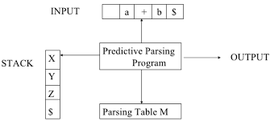
Predictive parsers
Parsing Table:
M [ A, a ]
Where A is a non-terminal and a is a terminal

Slide 17
Left Recursive Grammars
Example:
E → E+T | T
T → T*F | F
F → (E) | id
A general form
A → A α | β ------ immediate left recursion
OR
S → A α |b
A → Ac | Sd | ɛ ------- non-immediate left recursion

Slide 18
Left Recursive Grammars
A left recursive grammar can cause a Top down parser to go into an infinite loop.
A
A
α
A
α

Slide 19
Removing Left Recursion
Rule for removing immediate left recursion
A → A α | β
To be changed as
A → β A’
A’ → α A’ | є
Example:
E → E+T | T
T → T*F | F
F → (E) | id

Slide 20
Removing Left Recursion
Rule for removing immediate left recursion
A → A α | β
To be changed as
A → β A’
A’ → α A’ | є
Example:
E → T E’
E’ → +TE’ | є
T → F T’
T’ → * F T’ | є
F → (E) | id

Slide 21
Removing non-immediate left recursion
Algorithm:
Arrange the nonterminals in some order A1,A2,…,An
For (each i from 1 to n) {
For (each j from 1 to i-1) {
Replace each production of the form Ai → Aj γ
by the production Ai → δ1 γ | δ2 γ | … |δk γ
where Aj → δ1 | δ2 | … |δk are all current Aj productions
}
Eliminate left recursion among the Ai-productions
}

Slide 22
Removing non-immediate left recursion
Example 1:
S → A α |b
A → Ac | Sd | ɛ
Example 2:
A → Ba | Aa | c
B → Bb | Ab | d

Slide 23
Left Factoring
What happens if we are unable to decide now?
Delay the decision, wait for further input
Consider following grammar:
Stmt -> if expr then stmt else stmt
| if expr then stmt
On seeing input ‘if’ it is not clear for the parser which production to use
We can easily perform left factoring:
If we have A->αβ1 | αβ2 then we replace it with
A -> αA’
A’ -> β1 | β2

Slide 24
Left Factoring
Algorithm
For each non-terminal A, find the longest prefix α common to two or more of its alternatives.
If α<> ɛ, then replace all of A-productions
A → αβ1 |αβ2 | … | αβn | γ by
A → αA’ | γ
A’ → β1 |β2 | … | βn

Slide 25
Construction of Parsing Table
Step 1: Compute First and Follow sets
First set
First set for any symbol in the grammar contains the terminal symbols which can be found at the beginning of any string which can be generated from the symbol.

Slide 26
Construction of Parsing Table
Step 1: Compute First and Follow sets
First set
First set for any symbol in the grammar contains the terminal symbols which can be found at the beginning of any string which can be generated from the symbol.
Follow set
Follow(A), for non-terminal A, is the set of all terminals a that can appear immediately to the right of A in some setential form.

Slide 28
Construction of Parsing Table
Computing FIRST(X)
If X is a terminal, then FIRST (X) is X
If X → ɛ is a production, then add ɛ to FIRST(X)
If X is non-terminal and X → Y1 Y2 Y3 ….. Yk is a production, then place a in FIRST (X) if for some i, a is in FIRST (Y_{i}) and ɛ is in all of FIRST (Y1), FIRST (Y2) ….. FIRST (Y_{i-1})
If ɛ is in FIRST (Yj) for all j=1,2,...k; then add ɛ to FIRST (X)

Slide 29
Construction of Parsing Table
Computing FOLLOW (A)
Place $ in FOLLOW (S), where S is the start symbol
If there is a production A-→ α B β, then everything in FIRST (β) except ɛ is placed in FOLLOW (B)
If there is a production A-→ α B β, and FIRST (β) contains ɛ, then everything in FOLLOW (A) is in FOLLOW (B)
If there is a production A → α B, then everything in FOLLOW (A) is in FOLLOW (B)

Slide 30
Construction of Predictive Parsing Table
For each production A → α of the grammar, do the following steps -
For each terminal a in FIRST (α), add A-→ α to M [ A, a ]
If ɛ is in FIRST (α), add A-→ α to M [ A, b ] for each terminal b in
FOLLOW (A)
C) If ɛ is in FIRST (α) and $ is in FOLLOW (A), add A-→ α to M [ A, $]
Make each undefined entry of M “error”

Slide 31
Example
E -> TE’
E’ -> +TE’ | Ɛ
T -> FT’
T’ -> *FT’ | Ɛ
F -> (E) | id
E $ => TE’ $=> FT’E’ $=>idT’E’ $
=>idE’ $
id+TE’ $
Id+FT’E’ $
Id+id T’ E’ $
=>id+id E’ $ (T’→ e)
=> id+id $ (E’→ e)
Id+id$

Slide 32
Example
First
Follow
E -> TE’
E’ -> +TE’ | Ɛ
T -> FT’
T’ -> *FT’ | Ɛ
F -> (E) | id
F
T
E
E’
T’
{(,id}
{+, *, ), $}
{(,id}
{+, ), $}
{(,id}
{), $}
{+,ɛ}
{), $}
{*,ɛ}
{+, ), $}

Slide 33
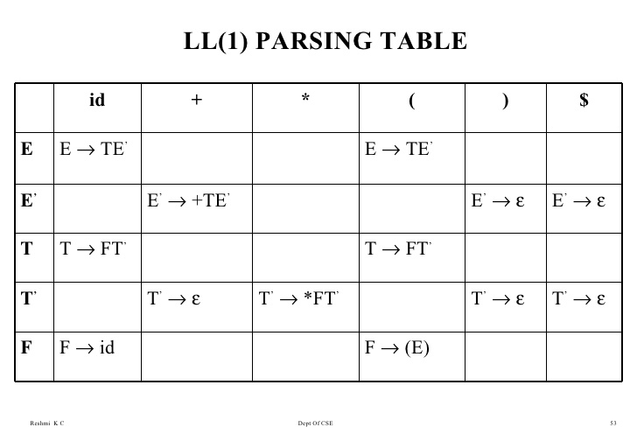
First
Follow
F
T
E
E’
T’
{(,id}
{+, *, ), $}
{(,id}
{+, ), $}
{(,id}
{), $}
{+,ɛ}
{), $}
{*,ɛ}
{+, ), $}

Slide 34
Error Recovery in LL(1) Parsers
A parser should try to determine that an error has occurred as soon as possible.
After an error has occurred, the parser should pick a likely place to resume the parse. A parser should try to parse as much code as possible.
A parser should try to avoid the error cascade problem.
A parser must avoid infinite loops as errors.
Panic-mode error recovery - skipping symbols on the input until a token in a selected set of synchronizing tokens.
A set of synchronising tokens are used for this purpose.

Slide 35
Error Recovery in LL(1) Parsers
Sets of synchronising tokens are directly built into the parsing table.
Given the non-terminal A on top of the stack and an input token that is not in FIRST(A) (or in FOLLOW(A) if ɛ is in FIRST(A)), there are the following three alternatives:
Pop A from the stack [if current input token is $ or is in FOLLOW(A)] – pop
Successively pop tokens from the input until a token is seen for which we restart the parse [if the current token is not $ and is not in FIRST(A) U FOLLOW(A)] – scan
Push a new non-terminal (usually start symbol) onto the stack and scan forward until a symbol in the FIRST set of start is found

Slide 36
Error Recovery in LL(1) Parsers
 | Id | + | * | ( | ) | $
E | E→TE’ | scan | scan | E→TE’ | pop | pop
E’ | scan | E’→+TE’ | scan | scan | E’→ë | E’→ë
T | T→FT’ | pop | scan | T→FT’ | pop | pop
T’ | scan | T’→ë | T’→*FT’ | scan | T’→ë | T’→ë
F | F→id | pop | pop | F→(E) | pop | pop

Slide 37
Home Work (to be submitted by midnight of 17th March)
Construct the LL(1) parsing table for the given grammars.
Show the parsing of the string aabbc using the left-side grammar.
What abnormality do you find in the right-side grammar?
Z → d
Z → XYZ
Y → ɛ
Y → c
X → Y
X → a
(Terminals = {a, c, d}, Non-terminals ={Z, X, Y}, Start Symbol = S
S --> ABC
A --> aA | ε
B --> bB | ε
C --> c
(Terminals = {a, b, c}, Non-terminals = {S, A, B}, Start Symbol = S)

